Slide 1
Module 06
Software Testing and Maintenance

Slide 2
Software Testing
Testing is the process of exercising a program with the specific intent of finding errors prior to delivery to the end user.

Slide 3

What Testing Shows
errors
requirements conformance
performance
an indication
of quality

Slide 4
Strategic Approach
To perform effective testing, you should conduct effective technical reviews. By doing this, many errors will be eliminated before testing commences.
Testing begins at the component level and works "outward" toward the integration of the entire computer-based system.
Different testing techniques are appropriate for different software engineering approaches and at different points in time.
Testing is conducted by the developer of the software and (for large projects) an independent test group.
Testing and debugging are different activities, but debugging must be accommodated in any testing strategy.

Slide 5
V & V
Verification refers to the set of tasks that ensure that software correctly implements a specific function.
Validation refers to a different set of tasks that ensure that the software that has been built is traceable to customer requirements. Boehm [Boe81] states this another way:
  Verification: "Are we building the product right?"
  Validation: "Are we building the right product?"

Slide 6


Who Tests the Software?
developer
independent tester
Understands the system
Must learn about the system,
but, will test "gently"
but, will attempt to break it
and, is driven by "delivery"
and, is driven by quality

Slide 7
Testing Strategy
System engineering
Analysis modeling
Design modeling
Code generation
Unit test
Integration test
Validation test
System test

Slide 8
Testing Strategy
We begin by ‘testing-in-the-small’ and move toward ‘testing-in-the-large’
For conventional software
  The module (component) is our initial focus
  Integration of modules follows
For OO software
  our focus when “testing in the small” changes from an individual module (the conventional view) to an OO class that encompasses attributes and operations and implies communication and collaboration

Slide 9


Unit Testing
module
to be
tested
results
software
engineer
test cases

Slide 10
Unit Testing
module
to be
tested
interface
local data structures
boundary conditions
independent paths
error handling paths
test cases

Slide 11
Unit Test Environment
driver
interface
local data structures
Module
boundary conditions
independent paths
error handling paths
stub
stub
test cases
RESULTS

Slide 12
Top Down Integration
A
top module is tested with
stubs
B
F
G
stubs are replaced one at
a time, "depth first"
C
as new modules are integrated,
some subset of tests is re-run
D
E

Slide 13
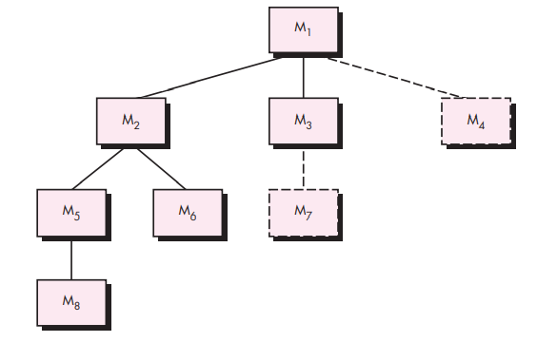

Top Down Integration

Slide 14
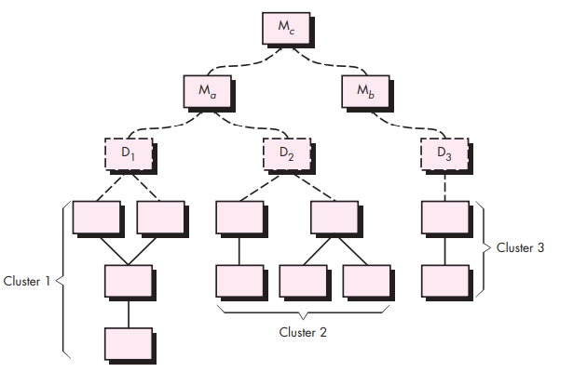
Bottom-Up Integration

Slide 15
Bottom-Up Integration
A
B
F
G
drivers are replaced one at a
time, "depth first"
C
worker modules are grouped into
builds and integrated
D
E
cluster

Slide 16
Regression Testing
Regression testing is the re-execution of some subset of tests that have already been conducted to ensure that changes have not propagated unintended side effects
Whenever software is corrected, some aspect of the software configuration (the program, its documentation, or the data that support it) is changed.
Regression testing helps to ensure that changes (due to testing or for other reasons) do not introduce unintended behavior or additional errors.
Regression testing may be conducted manually, by re-executing a subset of all test cases or using automated capture/playback tools.

Slide 17
Smoke Testing
A common approach for creating “daily builds” for product software
Smoke testing steps:
  Software components that have been translated into code are integrated into a “build.”
    A build includes all data files, libraries, reusable modules, and engineered components that are required to implement one or more product functions.
  A series of tests is designed to expose errors that will keep the build from properly performing its function.
    The intent should be to uncover “show stopper” errors that have the highest likelihood of throwing the software project behind schedule.
  The build is integrated with other builds and the entire product (in its current form) is smoke tested daily.
    The integration approach may be top down or bottom up.

